Slide 1
Introducing Computer Systems

Slide 2
Definition of Computer
In basic terms, a computer is an electronic device that process data, converting it into an information that is useful to people.
Any computer regardless of its type, is controlled by programmed instructions which give a machine a purpose and tell it what to do.

Slide 3
Computers for Individual Users
Desktop
Workstations
Laptops
Notebook Computers
Tablets
Smart Phones

Slide 4
Computers for Organizations
Network Servers
Mainframe Computers
Super Computers

Slide 5
Why Computers are so Important?
Manage your schedule on daily or hourly basis
Manage List of contacts
Send faxes and e-mails
Carry your data with you
Be able to work anywhere
Communicate and share data from anywhere
Education
Entertainment
Home based business
Population
Military
Police
Healthcare

Slide 6
Parts of Computer System
Hardware
Software
Data
User

Slide 7

Parts of Computer System
Hardware

Slide 8
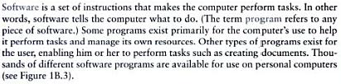
Parts of Computer System
Software

Slide 9

Parts of Computer System
Data
User
People are the computer operators

Slide 10
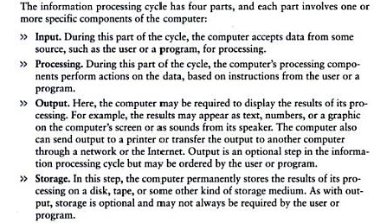
Information Process Cycle

Slide 11
Essential Computer Hardware
Processor
Memory
Input/Output
Storage

Slide 12
Essential Computer Hardware
Processor: A central processing unit (CPU), also called a central processor or main processor, is the electronic circuitry within a computer that executes instructions that make up a computer program. The CPU performs basic arithmetic, logic, controlling, and input/output (I/O) operations specified by the instructions in the program.
Most modern CPUs are microprocessors, where the CPU is contained on a single metal-oxide-semiconductor (MOS) integrated circuit (IC) chip.

Slide 13

Essential Computer Hardware
Memory: In computing, memory refers to a device that is used to store information for immediate use in a computer or related computer hardware device
RAM (Random Access Memory)
ROM (Read Only Memory)
ROM permanently stores its data even if the computer is shut off.
ROM is called non-volatile memory because it never loses its contents.

Slide 14

Essential Computer Hardware
Input/Output:
Examples of Input Devices:
Keyboard
Touchpad
Scanner
Digital Camera
Microphone
Joystick
Mouse etc
Examples of Output Devices:
Screen
Speaker
Printer
Digital Camera etc

Slide 15

Essential Computer Hardware
Storage:
Types of Storage
Magnetic Storage
Optical Storage

Slide 16
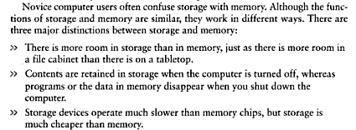
Difference between Storage and Memory

Slide 17
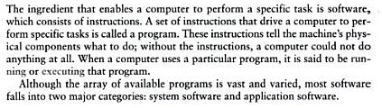
Software

Slide 18
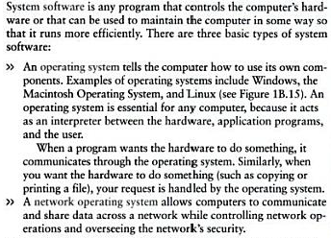
System Software

Slide 19
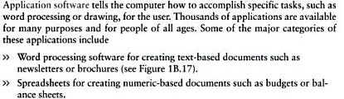
Application Software
More Examples:
Database Management Software
Presentation Programs
Graphic Programs
Multimedia Authoring Applications
Entertainment and Education Software
Web Design Tool ad Web Browsers

